Slide 1
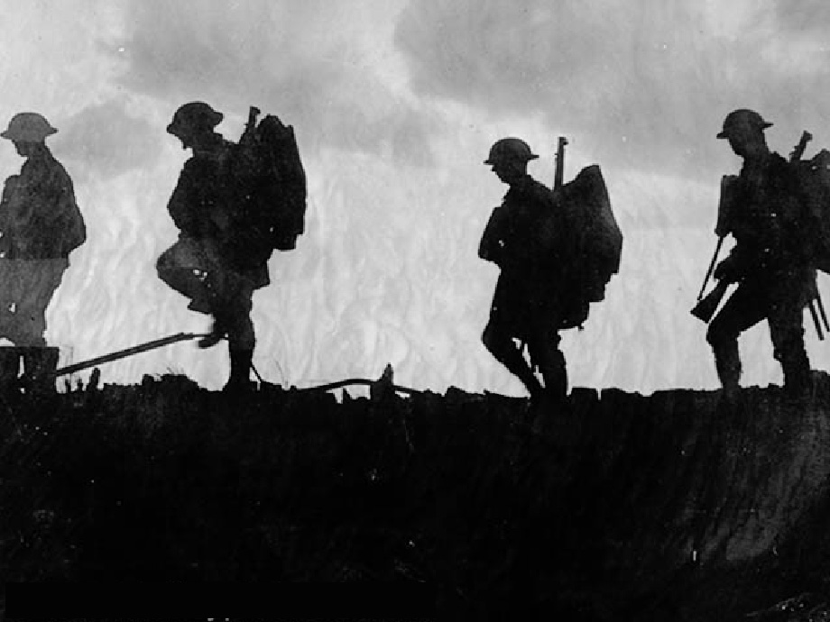
Long-Term Causes to WWI
Militarism
Alliances
Imperialism
Nationalism
M.A.I.N.

Slide 2
Militarism
Glorification of war & in military spending
Germany vs. England for naval superiority (this threatened rest of Europe)
= Arms race

Slide 3
Alliances
Web of treaties to protect themselves
Triple Alliance: Germany, Austria-Hungary, and Italy (agreed to help each other if attacked)
Triple Entente: France, Russia, and Great Britain (treaty of friendship, not military, formed mutual distrust of Germany).
What do you see here?
What do the colors represent?
Who is allied to whom?
Why might these countries make alliances?

Slide 4
Imperialism
European nations competed for colonies
Germany now seen as threat due to their imperialistic intentions
Conquered persons resented imperial powers

Slide 5
Nationalism
Great pride in one’s country or aspiring to become one’s own country
Uniting force
= patriotism + sense of superiority
Germany & Italy: recently united, indep countries
Many countries torn by tensions of different nationalist groups
Border/territorial disputes fueled rivalries
tensions in Europe

Slide 6
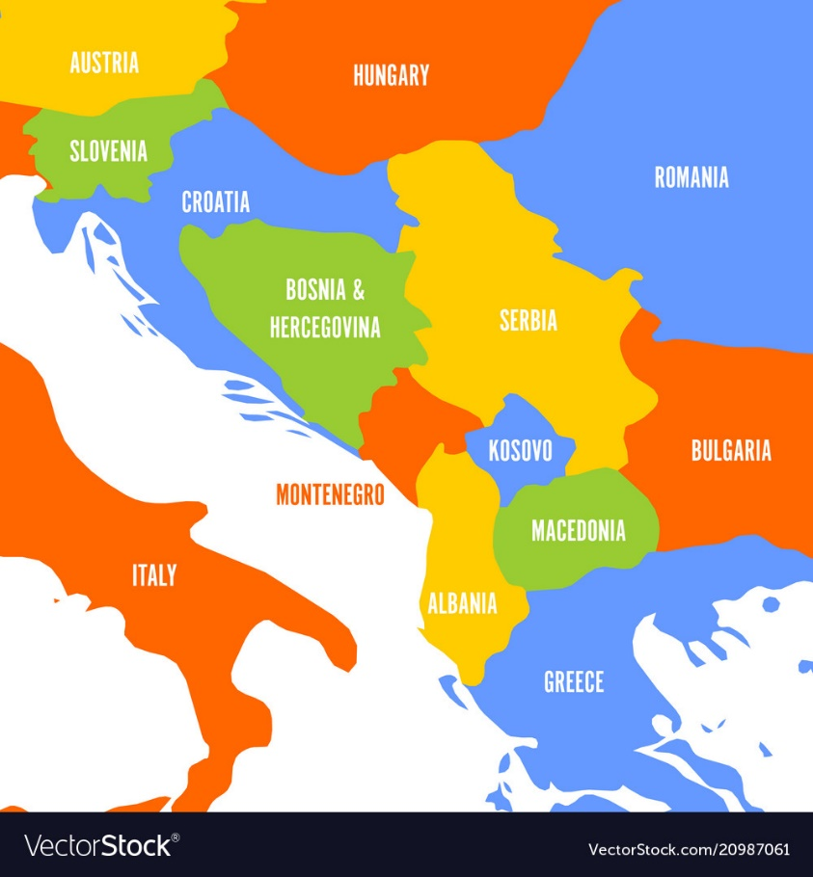
Nationalism in the Balkans
Area w/people of diverse religions, ethnic backgrounds, languages
As Ottoman Empire receded, new nations were born
Russia & Austria competed for control of new nations
Austria-Hungary takes Bosnia in 1908 and Serbia resents this (wants its own homeland)

