Slide 1
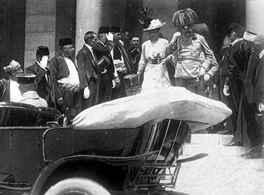
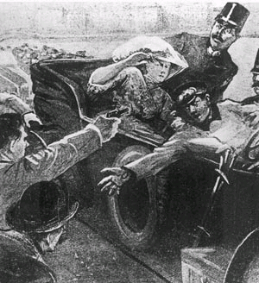
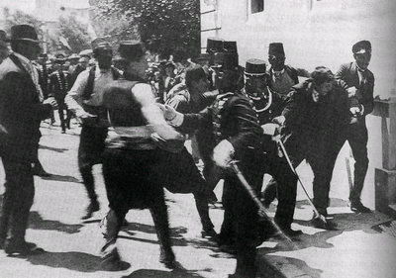
Immediate Cause to WWI:
Assassination of Archduke Franz Ferdinand
Watch video clip:
Days that Shook the World

Slide 2
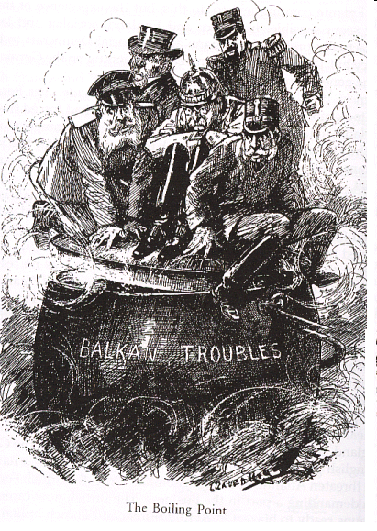
The Balkan Powder Keg
Rulers of Germany, France, Russia, Austria-Hungary and the United Kingdom attempted to keep the lid on the powder keg of imperialist and nationalist tensions in the Balkans to prevent a general European war.

Slide 3
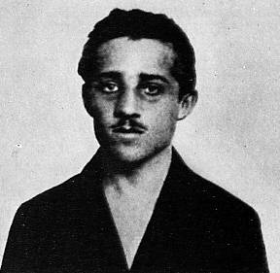
The Assassination of the Archduke
Archduke Francis Ferdinand of Austria visited Bosnian capital, June 1914
7 assassins from the Black Hand, a Serbian nationalist groups, plot against him.
19-yr-old Gavrilo Princip shot the Archduke and his wife (June 28, 1914).

